Slide 1


Loan Eligibility Prediction
Using Machine Learning to Improve Decision-Making
Prepared by :
Jalila Muadi – 1201611
Manar Mansour-1201816
Date: 2/2/2024
MM

Slide 2
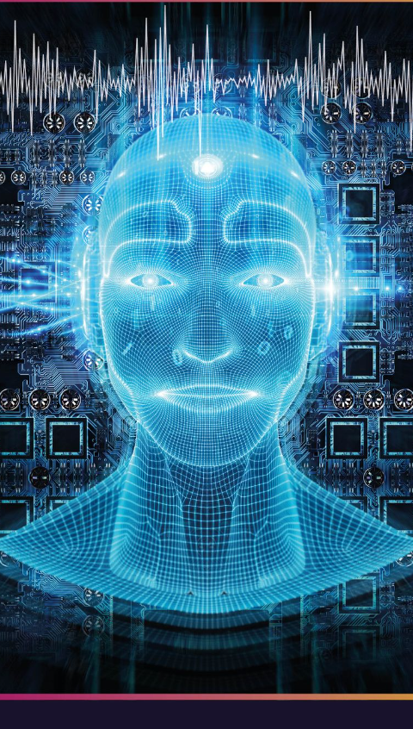
Introduction
The loan prediction machine learning model serves as a crucial tool for evaluating a customer's loan status and crafting effective strategies. By analyzing key borrower attributes, this model identifies the essential factors influencing the customer's loan status. Ultimately, it generates predictive insights, facilitating decision-making for bank managers. These predictive reports not only simplify but also expedite the loan approval process, enhancing operational efficiency within financial institutions.

Slide 3

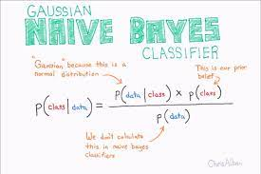
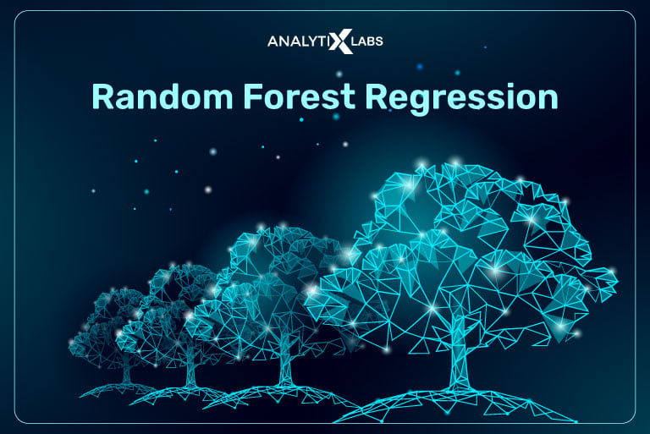
Dataset and Data Preprocessing
Machine Learning Application
To apply machine learning algorithms in real-world scenarios, we employed a dataset. For predicting loan approvals, three different models we utilized: Decision Trees, Naive Bayes, and Random Forests.
Data Set
We used a training dataset obtained from online sources, requiring dataset cleaning, by removing duplicate rows and handling missing values. The categorical columns were transformed into a numerical format to facilitate model training.
Tools Used
The tool used for creating the loan eligibility prediction project is Python. We utilized libraries such as Pandas, scikit-learn, and Tabulate for various tasks within the project.

Slide 4

Dataset Key Information
Loan ID
Gender
Married
Dependents
Education
Self Employed
Applicant Income
CoapplicantIncome
Loan Amount
Loan Amount Term
Credit History
Property Area
Loan Status

Slide 5
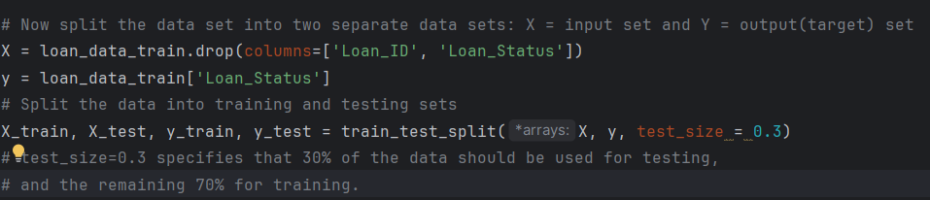
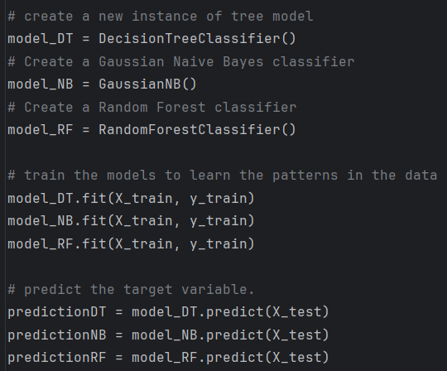
Model’s Selection and Training
Model Training
We utilized the scikit-learn library in Python to train our machine learning models. The training set was split into input (X) and target (y) sets. Each model was trained on the X_train and y_train datasets.
Model Testing
The trained models were tested using the same X_test dataset. and Predictions were obtained, and performance metrics were calculated.

Slide 6
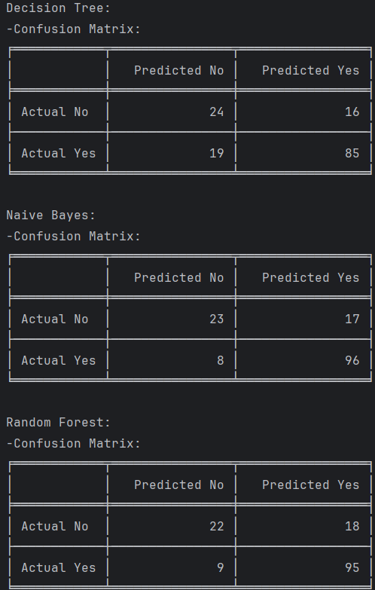
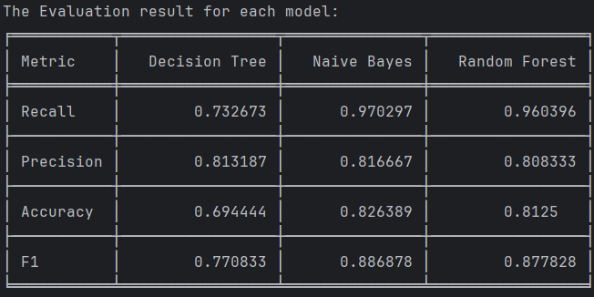
Results - Model Evaluation
Overall Comparison
Naive Bayes stands out for having the highest recall and accuracy. It is particularly effective at identifying individuals eligible for a loan. Decision Tree has a slightly lower recall and accuracy compared to Naive Bayes but maintains a good balance between precision and recall. Random Forest performs well overall, with high recall and a balanced precision-recall trade-off.
Considerations
The choice of the best model depends on the specific goals and constraints of the loan eligibility prediction task. If the emphasis is on identifying as many eligible candidates as possible (high recall), Naive Bayes is a strong choice and so on..

Slide 7
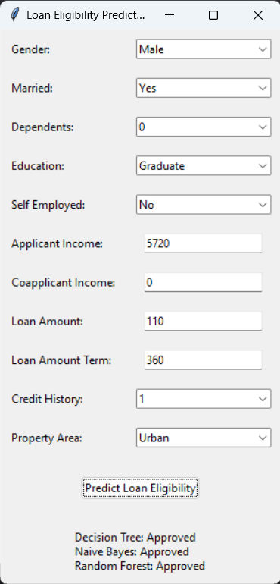
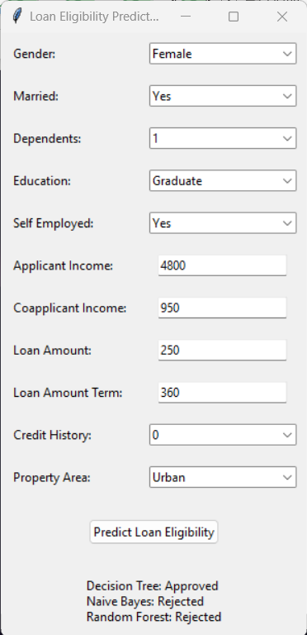
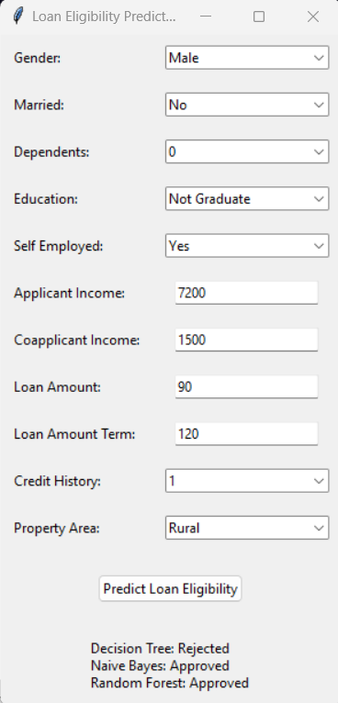
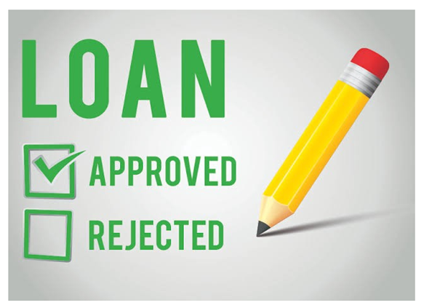
Interactive GUI

Slide 8


Conclusion
The "Loan Eligibility Prediction" project demonstrates the application of supervised learning techniques to solve a real-life problem. The comparative analysis of different learning algorithms provides insights into the strengths and weaknesses of each model. The project aims to contribute to the understanding of machine learning in the context of predicting loan eligibility and encourages further exploration in the field.

